Slide 1
eCPAT Park Search
Week of 2/26/17 Progress Report

Slide 2
Implementation Process
Created a skeleton using an ASP.NET MVC project
Explore HTML/CSS, Javascript, SQL

Slide 3
Synchronization Process
Visual Studios Team Service
Collaborative coding (Ryan- HTML/CSS, Chris- JS, Connon-DB)

Slide 4
Prototype Plans
Enter Location
Query “mock DB” for results
Filter results with a query
Select result to generate Park Info page.
View Park Info page
Park Picture
Park General Info
Park Amenities

Slide 5
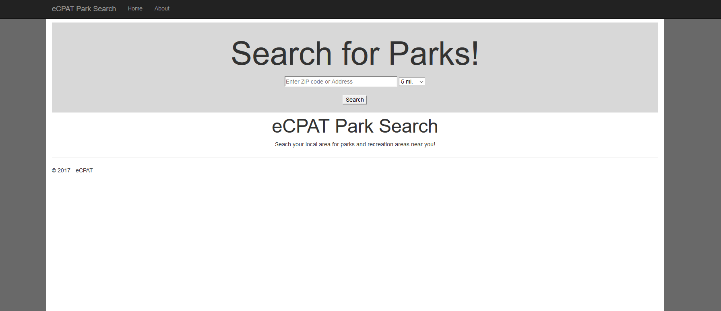

Slide 6
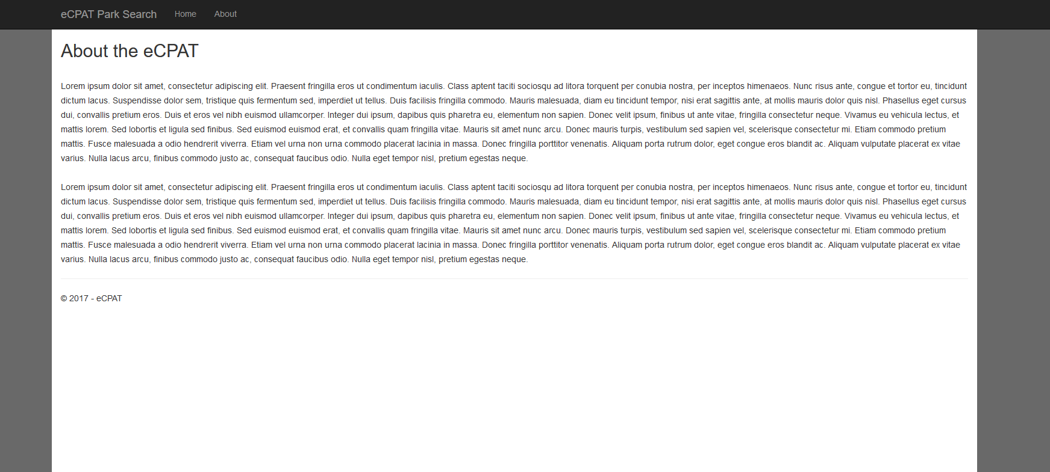

Slide 7
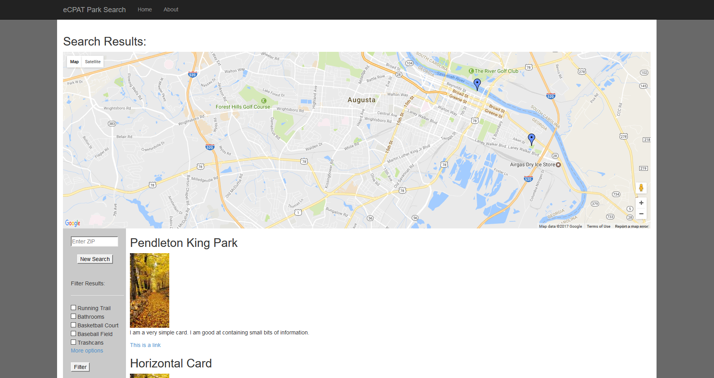

Slide 8
